Slide 1
Claims against a thief
Nicole Langlois

Slide 2
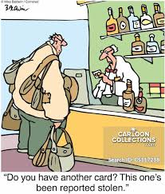

Slide 3
Personal claims
Common law
Conversion (tort)
Unjust enrichment
Equity
Claim for breach of trust

Slide 4
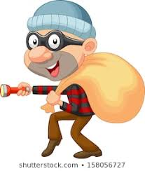
Money
Hall v Dean (1600) Cro. Eliz. 841
Miller v Race (1758) 1 Burr 452;
Lipkin Gorman v Karpnale Ltd [1991] 2 A.C 548, at 559

Slide 5
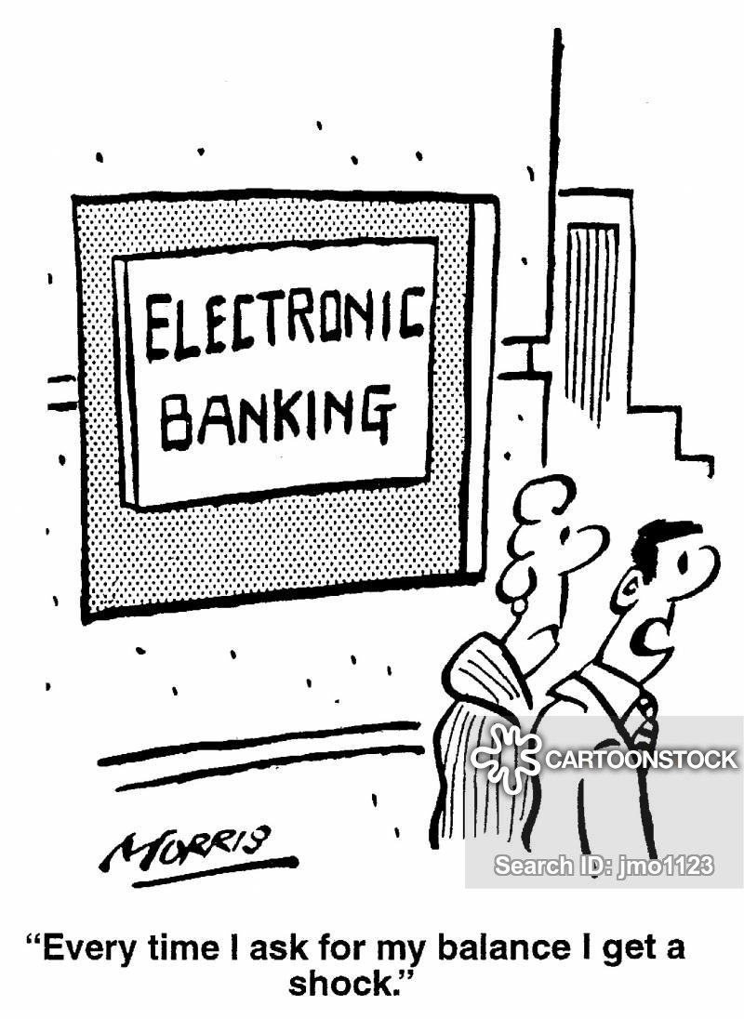
Choses in action

Slide 6
Unjust enrichment
Lipkin Gorman v Karpnale Ltd [1991] 2 AC 548

Slide 7
Proprietary claims
Westdeutsche Landesbank Girozentrale v Islington L.B.C. [1996] UKHL 12
Shalson v Russo [2003] EWHC 1637
CMOC Sales and Marketing Limited v Persons Unknown [2018] EWHC 2230

Slide 8
Some concluding thoughts…
“Stealing, of course, is a crime, and a very impolite thing to do. But like most impolite things, it is excusable under certain circumstances. Stealing is not excusable if, for instance, you are in a museum and you decide that a certain painting would look better in your house, and you simply grab the painting and take it there. But if you were very, very hungry, and you had no way of obtaining money, it would be excusable to grab the painting, take it to your house, and eat it.”
― Lemony Snicket, The Wide Window

